Slide 1

NAME :- SUBHAM DUTTA
ROLL NO :- 16800117012
REG. NO :- 171680110052
STREAM :- CSE
SUBJECT :- COMPUTER NETWORKING
PPT TOPIC :- BIT-STUFFING & CHARACTER-STUFFING

Slide 2
BIT STUFFING AND CHARACTER STUFFING

Slide 3

Bit Stuffing in Computer Network
Data link layer is responsible for something called Framing, which is the division of stream of bits from network layer into manageable units (called frames). Frames could be of fixed size or variable size. In variable-size framing, we need a way to define the end of the frame and the beginning of the next frame.
Bit stuffing is the insertion of non information bits into data. Note that stuffed bits should not be confused with overhead bits. Overhead bits are non-data bits that are necessary for transmission (usually as part of headers, checksums etc.).

Slide 4
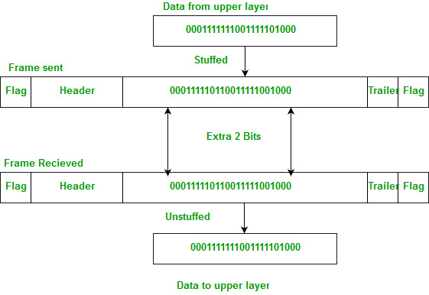
Bit Stuffing Mechanism :-
In a data link frame, the delimiting flag sequence generally contains six or more consecutive 1s. In order to differentiate the message from the flag in case of the same sequence, a single bit is stuffed in the message. Whenever a 0 bit is followed by five consecutive 1bits in the message, an extra 0 bit is stuffed at the end of the five 1s.
When the receiver receives the message, it removes the stuffed 0s after each sequence of five 1s. The un-stuffed message is then sent to the upper layers.

Slide 5
Applications of Bit Stuffing :-
1. Synchronize several channels before multiplexing.
2. Rate-match two single channels to each other.
3. Run length limited coding.
Run length limited coding :–
To limit the number of consecutive bits of the same value(i.e., binary value) in the data to be transmitted. A bit of the opposite value is inserted after the maximum allowed number of consecutive bits.
Bit stuffing technique does not ensure that the sent data is intact at the receiver side (i.e., not corrupted by transmission errors). It is merely a way to ensure that the transmission starts and ends at the correct places.

Slide 6
Disadvantages of Bit Stuffing :– The code rate is unpredictable; it depends on the data being transmitted.
Example of bit stuffing :– Bit sequence: 110101111101011111101011111110 (without bit stuffing) Bit sequence: 110101111100101111101010111110110 (with bit stuffing)
After 5 consecutive 1-bits, a 0-bit is stuffed. Stuffed bits are marked bold.

Slide 7
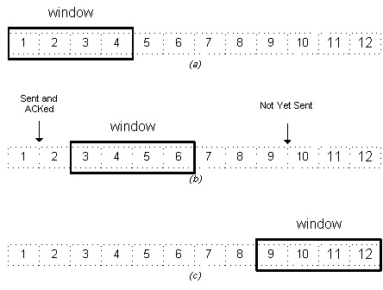
Character Stuffing In Computer Networks
Same idea as bit-stuffing, but operates on bytes instead of bits.
Use reserved characters to indicate the start and end of a frame. For instance, use the two-character sequence DLE STX (Data-Link Escape, Start of TeXt) to signal the beginning of a frame, and the sequence DLE ETX (End of TeXt) to flag the frame's end.

Slide 8
Problem :-
What happens if the two-character sequence DLE ETX happens to appear in the frame itself?
Solution :-
Use character stuffing; within the frame, replace every occurrence of DLE with the two-character sequence DLE DLE. The receiver reverses the processes, replacing every occurrence of DLE DLE with a single DLE.

Slide 9
Example :-
If the frame contained “A B DLE D E DLE”, the characters transmitted over the channel would be “DLE STX A B DLE DLE D E DLE DLE DLE ETX”.
Disadvantage :-
Character is the smallest unit that can be operated on; not all architectures are byte oriented.

Slide 10
THANK YOU SIR

